Slide 1




Slide 2


Problem Description
Inspiration
App Overview
Features
Userflow
Timeline

Slide 3


PROBLEM
DESCRIPTION
During cricket matches, keeping track of scores is a cumbersome task. The conventional pen-paper approach consists of many issues.
Cricket fans have limited access to real-time statistics and analysis during matches, which can make it difficult to understand player and team performance fully.
The available statistics can be complex and difficult to interpret, making it challenging for fans to make informed predictions or analyze the game themselves. This lack of easily accessible and user-friendly cricket match statistics and analysis has created a need for a platform like Stat11.

Slide 4


INSPIRATION
In the fast-paced world of cricket, keeping up with real-time statistics and analysis can be a daunting task. With matches happening around the clock, it's easy to miss out on the latest scores and insights that can make all the difference in understanding the game.
That's where Stat11 comes in - a web application designed to provide users with up-to-date statistics and analysis for cricket matches. Whether you're a die-hard fan or just getting into the game, Stat11 makes it easy to stay on top of the latest scores and trends in the world of cricket.

Slide 5




APP OVERVIEW
Real-time Statistics
No Authentication
Unique
Responsive
Stat11's clean and intuitive user interface makes it easy for users to access real-time statistics and analysis for cricket matches.
Users can access Stat11 on their mobile devices, tablets, laptops, and desktops,
Real-time statistics/graphs for cricket matches allowing users to stay updated with the latest scores, player performance, and team rankings.
No Authentication required for general users to see matches

Slide 6





Features
Clean user interface:
Open access:
Stat11 has a clean and intuitive user interface, making it easy for users to access and use the app. The user interface is designed to be user-friendly and provide a seamless experience.
The app is open to the general public, meaning that users don't need to authenticate or login to access the app.
Match analysis:
Interactive charts:
The app provides match analysis for cricket matches, allowing users to view detailed insights into the performance of teams and players.
The app features interactive charts that allow users to analyze and compare data easily. Users can customize the charts to show specific data and view trends over time.

Slide 7
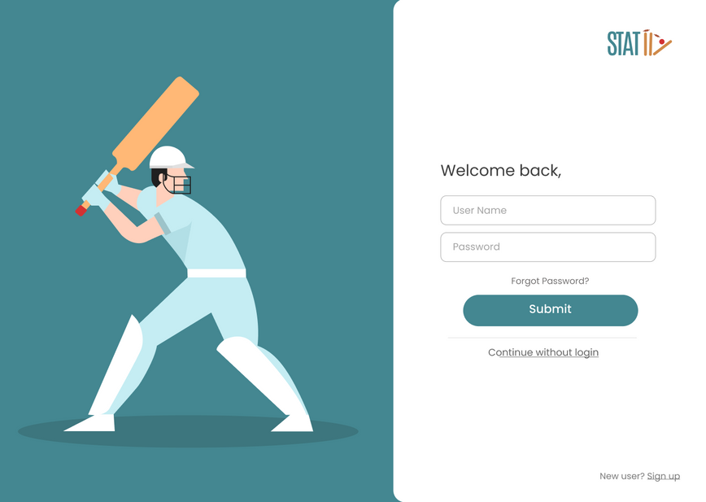
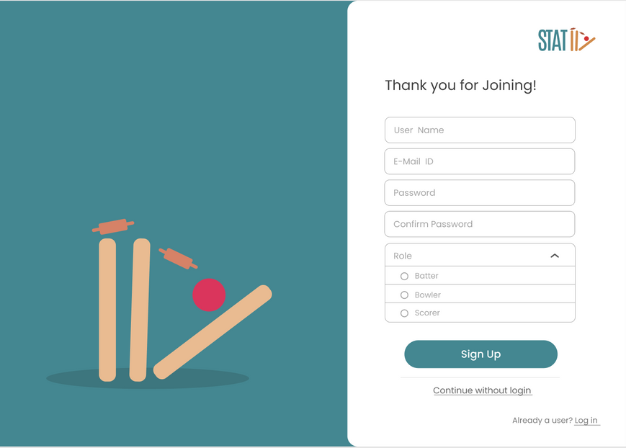

USER FLOW
LOGIN PAGE
SIGN UP PAGE

Slide 8
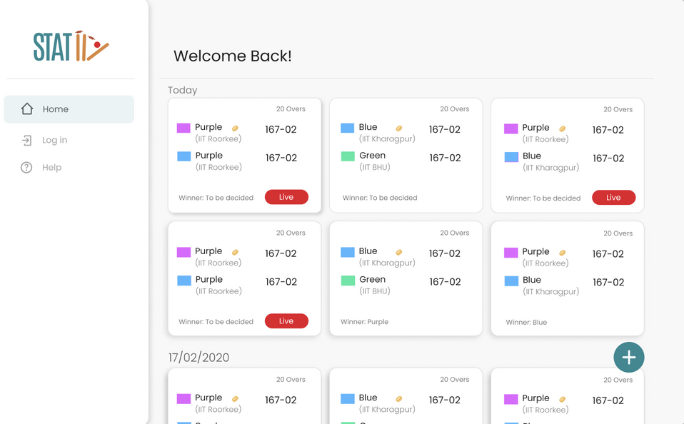
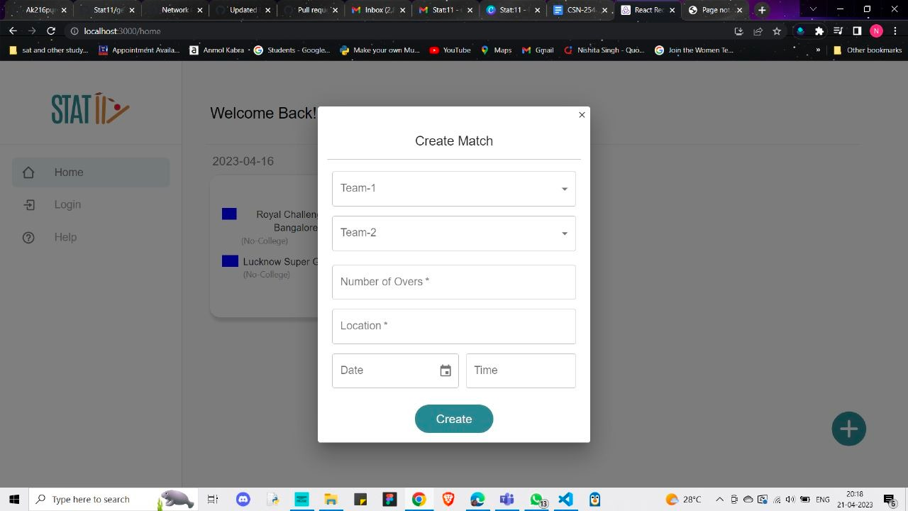

ADMIN VIEW
HOME SCREEN
ADD A MATCH

Slide 9
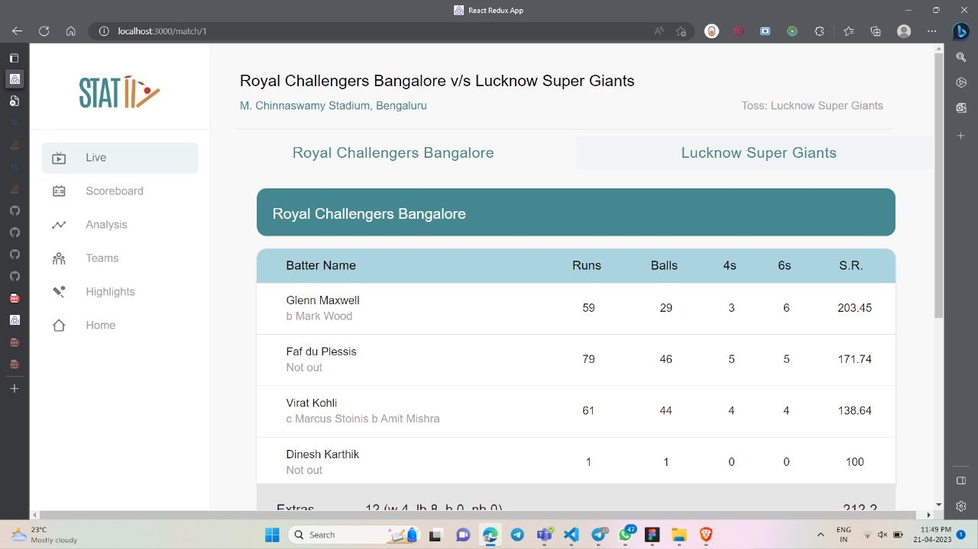
Score Card

Slide 10
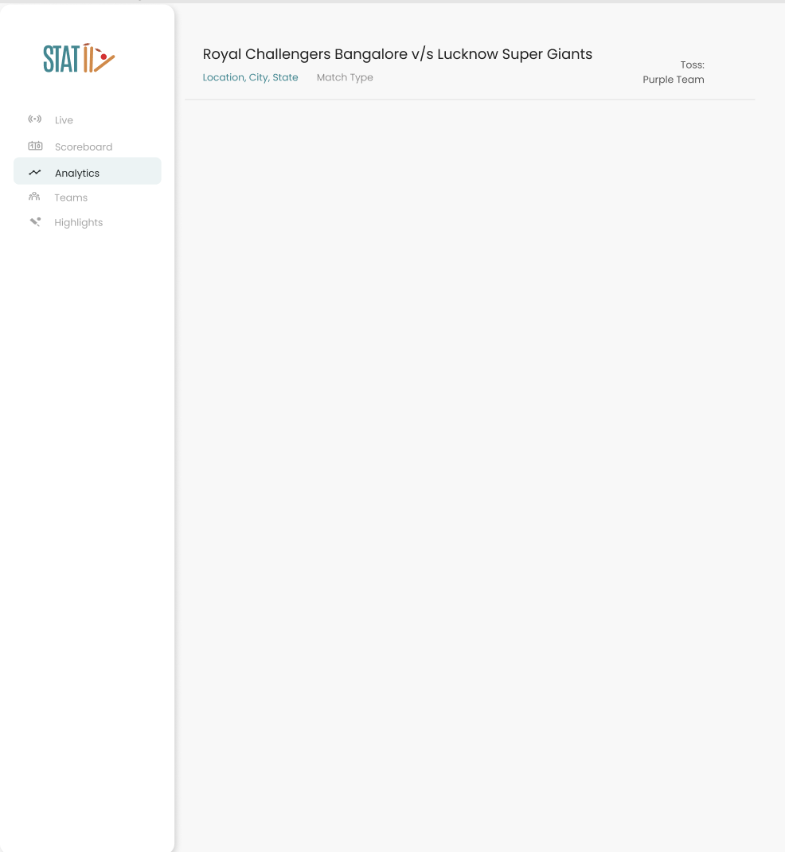
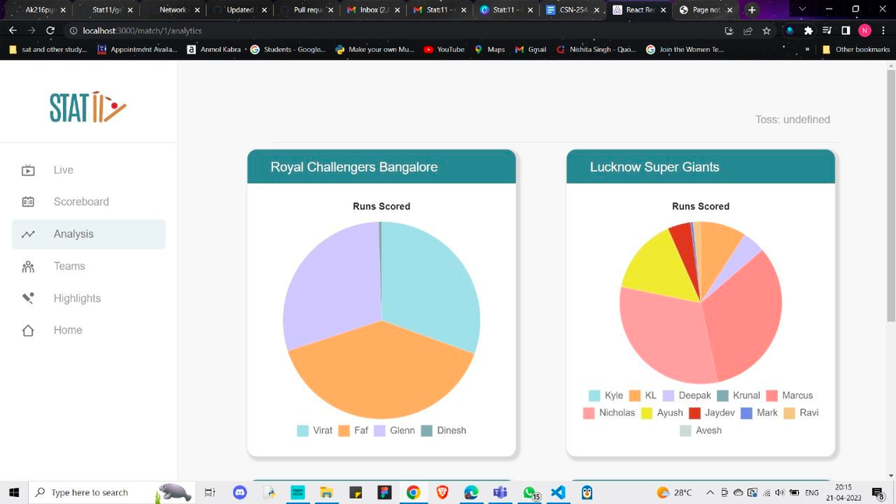

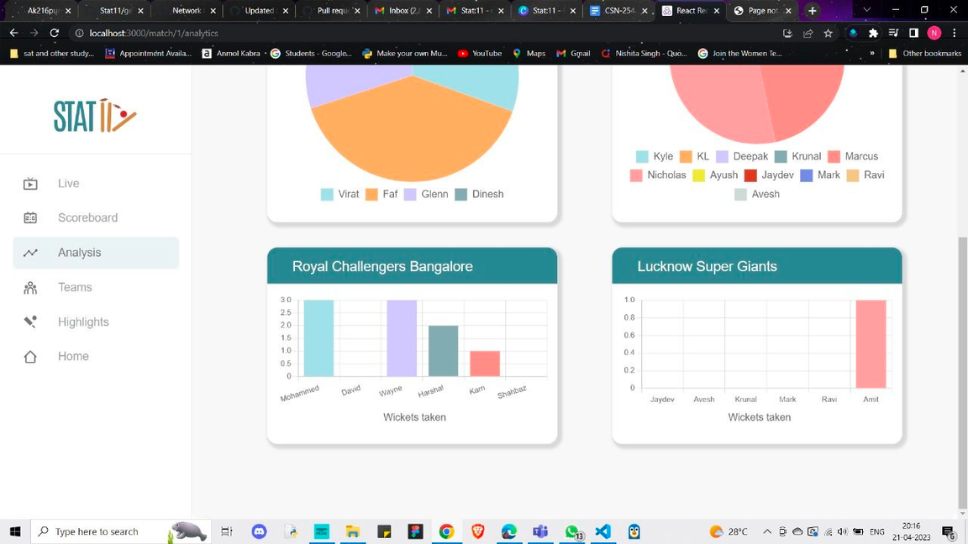

ANALYTICS & CHARTS

Slide 11

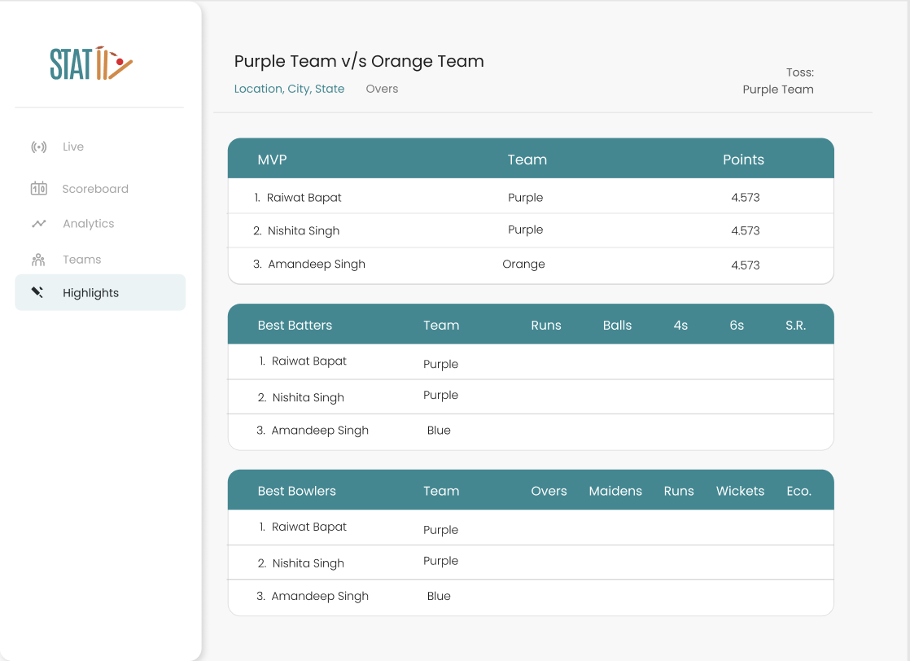

HIGHLIGHTS

Slide 12


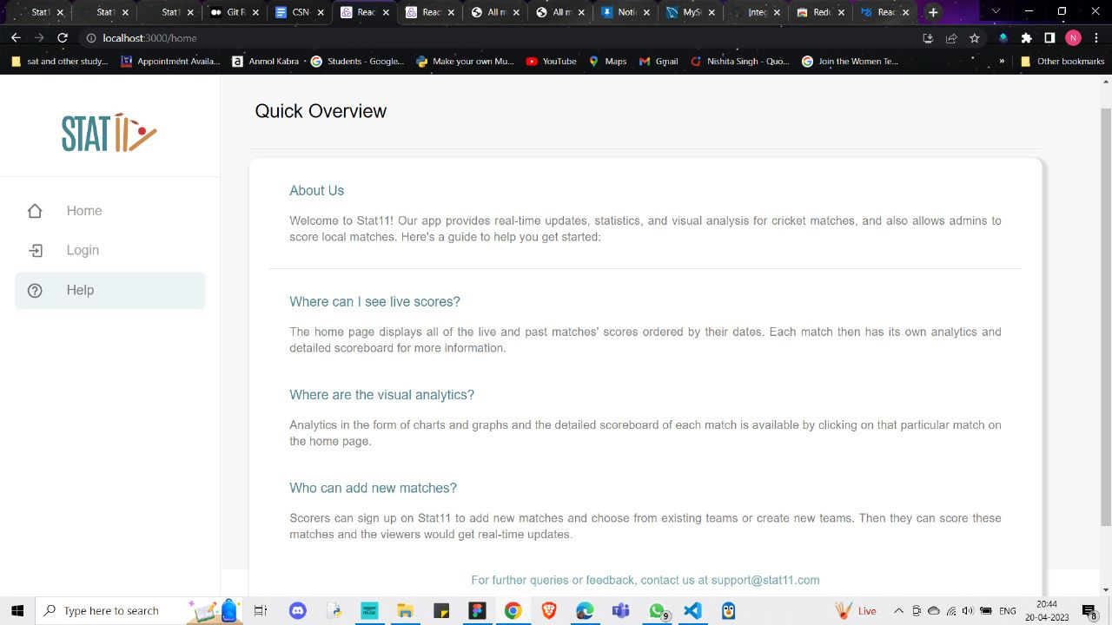
HELP SCREEN

Slide 13

TIMELINE
Developing using Backend Technologies
Final Debugging, Resolving any issues
Ideation & Planning
Backend
Frontend
Debugging
Learned Tools tech of React, React Toolkit & Material UI
Creating UI and connected it with backend
Notes:
COMING TO THE TIMELINE OF THE APP, we divied the project into 4 diff parts following agile development, The starting was the ideation & planning in which we mostly did the research and learned the tech stacks required to make the app, THen followed by the backend, in this we developed the backend technologies and made the database of the app then comes front end, we made the UI of the app and connected it with the backend to achieve the goals of our app then comes the final step that is debugging , We resolved any conflicts ,merged branch and did final debugging of the app to achieve the final product.

Slide 14







OUR TEAM MEMBERS
AKHIL PUNIA
AMANDEEP SINGH
MANASHREE KALODE
NISHITA SINGH
RAIWAT BAPAT
SUBHAJIT BISWAS

Slide 15
EXPERIENCE THE THRILL OF CRICKET MATCHES LIKE NEVER BEFORE WITH STAT11
Notes:
"Whether you're a casual cricket fan or a die-hard enthusiast, you're sure to experience the thrill of cricket matches like never before with Stat11.

